Slide 1

Machine Learning with Python
Explore the dynamic synergy between Machine Learning and Python, powering advancements in AI and data science. This presentation focuses on practical implementation within the Indian context, highlighting its growing significance.

Slide 2



What is Machine Learning?
AI Subset
Improved Predictions
Data-Driven Outcomes
Machine Learning is a subset of Artificial Intelligence, enabling systems to learn and adapt from data without explicit programming.
It significantly improves prediction accuracy by identifying patterns and relationships within historical datasets.
Leveraging past data, ML algorithms are trained to forecast new outcomes and make informed, intelligent decisions.

Slide 3

Importance and Applications of ML
Machine Learning is pivotal for understanding customer behaviour, driving product innovation, and gaining a competitive edge in today's market.
Leading companies like Facebook, Google, and Uber extensively utilise ML to enhance their services and operations, staying ahead of the curve.
Its diverse applications span recommendation engines, fraud detection, speech recognition, and even advanced medical diagnosis, transforming various industries.

Slide 4




Types of Machine Learning
Supervised Learning
Unsupervised Learning
Uses labelled data for tasks like classification and regression, where the model learns from known inputs and outputs.
Works with unlabelled data, identifying hidden patterns for clustering and anomaly detection without prior output knowledge.
Reinforcement Learning
Semi-supervised Learning
Learns through trial and error, receiving feedback and rewards from its environment to make optimal decisions.
Combines aspects of both, utilising a mix of labelled and unlabelled data for improved learning efficiency.

Slide 5
Popular ML Algorithms in Python
K-Nearest Neighbours
Decision Trees
Naive Bayes
Classifies data points based on the similarity of their closest neighbours.
Uses a flowchart-like structure for classification and regression, making decisions based on features.
A probabilistic classifier that applies Bayes' theorem with strong independence assumptions.
Support Vector Machines
Linear Regression
Finds the optimal hyperplane to separate data into classes with the largest margin.
Models the linear relationship between a dependent variable and one or more independent variables.

Slide 6


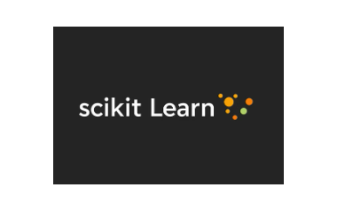




Python Libraries for Machine Learning
NumPy & Pandas: Essential for efficient data manipulation and analysis.
Scikit-learn: A comprehensive library offering a wide range of ML algorithms and tools.
Matplotlib & Seaborn: Powerful tools for creating insightful data visualisations.
TensorFlow & PyTorch: Leading frameworks for advanced deep learning applications.

Slide 7




Machine Learning Process Using Python
Data Preparation
Model Training
Collecting, cleaning, and selecting relevant features from raw data.
Training the algorithm on prepared data and evaluating its performance using metrics like accuracy and precision.
Tuning & Validation
Deployment & Prediction
Optimising model parameters through hyperparameter tuning and cross-validation for robustness.
Deploying the trained model to make predictions on new, unseen data.

Slide 8
Conclusion & Future Trends
Machine Learning with Python empowers the development of scalable and efficient AI solutions, driving innovation across sectors.
The demand for ML expertise is surging in Indian industries, notably finance, healthcare, and e-commerce, creating vast opportunities.
Emerging trends like AutoML, explainable AI, and edge ML are shaping the future, necessitating continuous learning for data scientists and developers.

Slide 9
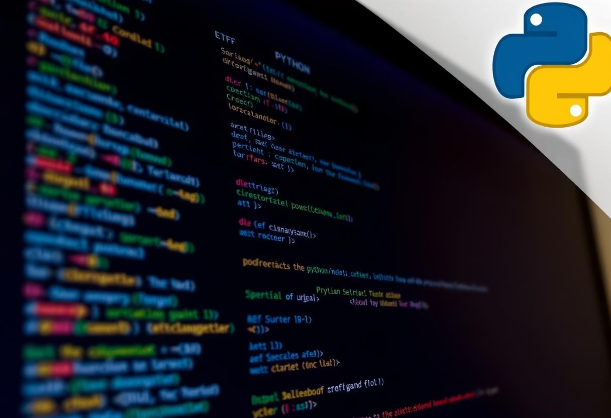
Introduction to Programming & Python
Readability & Simplicity
Rich Ecosystem
Versatility & Community
Python's intuitive syntax makes it easy to learn and write, accelerating ML model development.
Access to a vast collection of libraries like NumPy and Pandas, simplifying complex data operations.
Widely adopted for diverse applications, backed by a strong global community for continuous innovation.

Slide 10

Introduction to Python
Python is an ideal language for Machine Learning due to its clear syntax, extensive libraries, and strong community support. Its versatility allows for rapid prototyping and deployment of ML models.
The simplicity of Python reduces development time, making it a favourite among data scientists and ML engineers alike.
1
2
3
Ease of Learning
Vast Libraries
Community Support
Simplified syntax aids quick grasp of ML concepts.
Rich ecosystem like NumPy, Pandas, Scikit-learn for ML.
Large, active community for problem-solving and innovation.

Slide 11
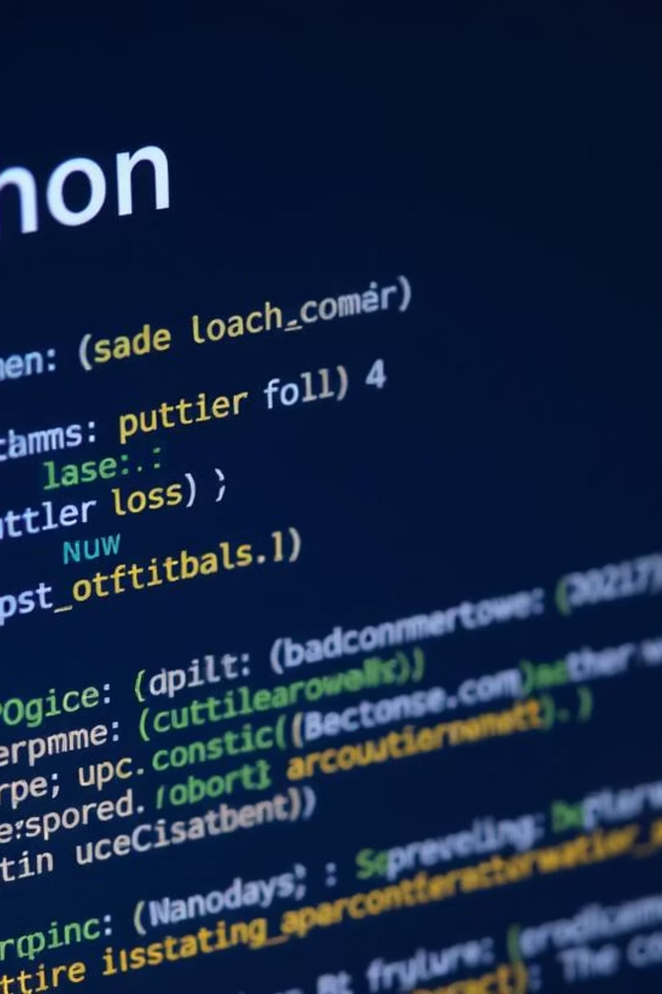


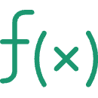

Python Basics
Variables & Data Types
Fundamental to storing information like numbers, strings, and booleans. Python's dynamic typing simplifies declaration.
Control Flow
Uses if/else statements for conditional execution and for/while loops for repetitive tasks, vital for algorithm logic.
Functions & Modules
Reusable blocks of code (functions) and organised collections of functions (modules) enhance code efficiency and structure.
Data Structures
Python's built-in lists, dictionaries, and sets are crucial for organising and manipulating data effectively in ML pipelines.

Slide 12
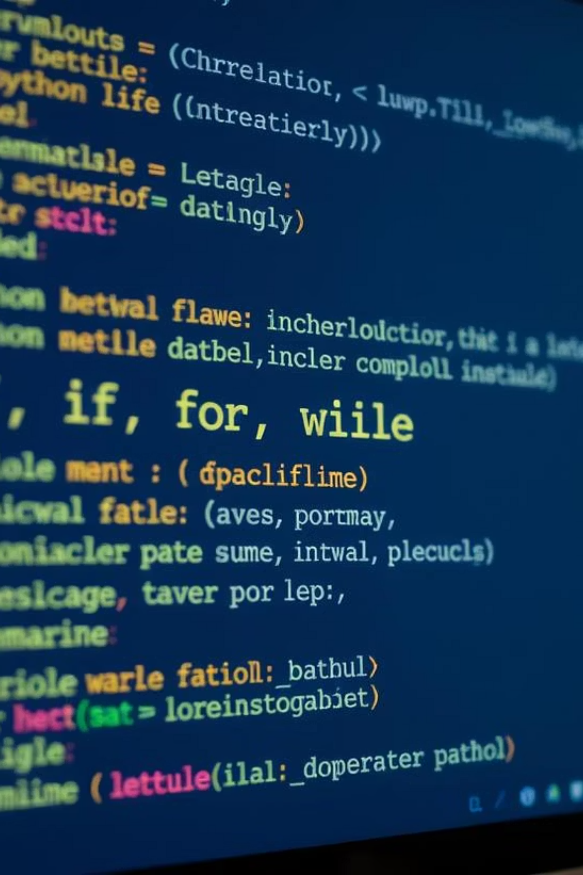
Control Flow Statements
Control flow statements are fundamental in Python, enabling programmes to make decisions, execute tasks repeatedly, and manage the order of operations based on conditions.
Conditional (if-elif-else)
Execute specific blocks of code only when certain conditions are met.
Looping (for & while)
Repeat a block of code multiple times, either for a fixed number of iterations or until a condition is false.
Jump (break & continue)
Alter the normal flow within loops, allowing early exits or skipping current iterations.

Slide 13




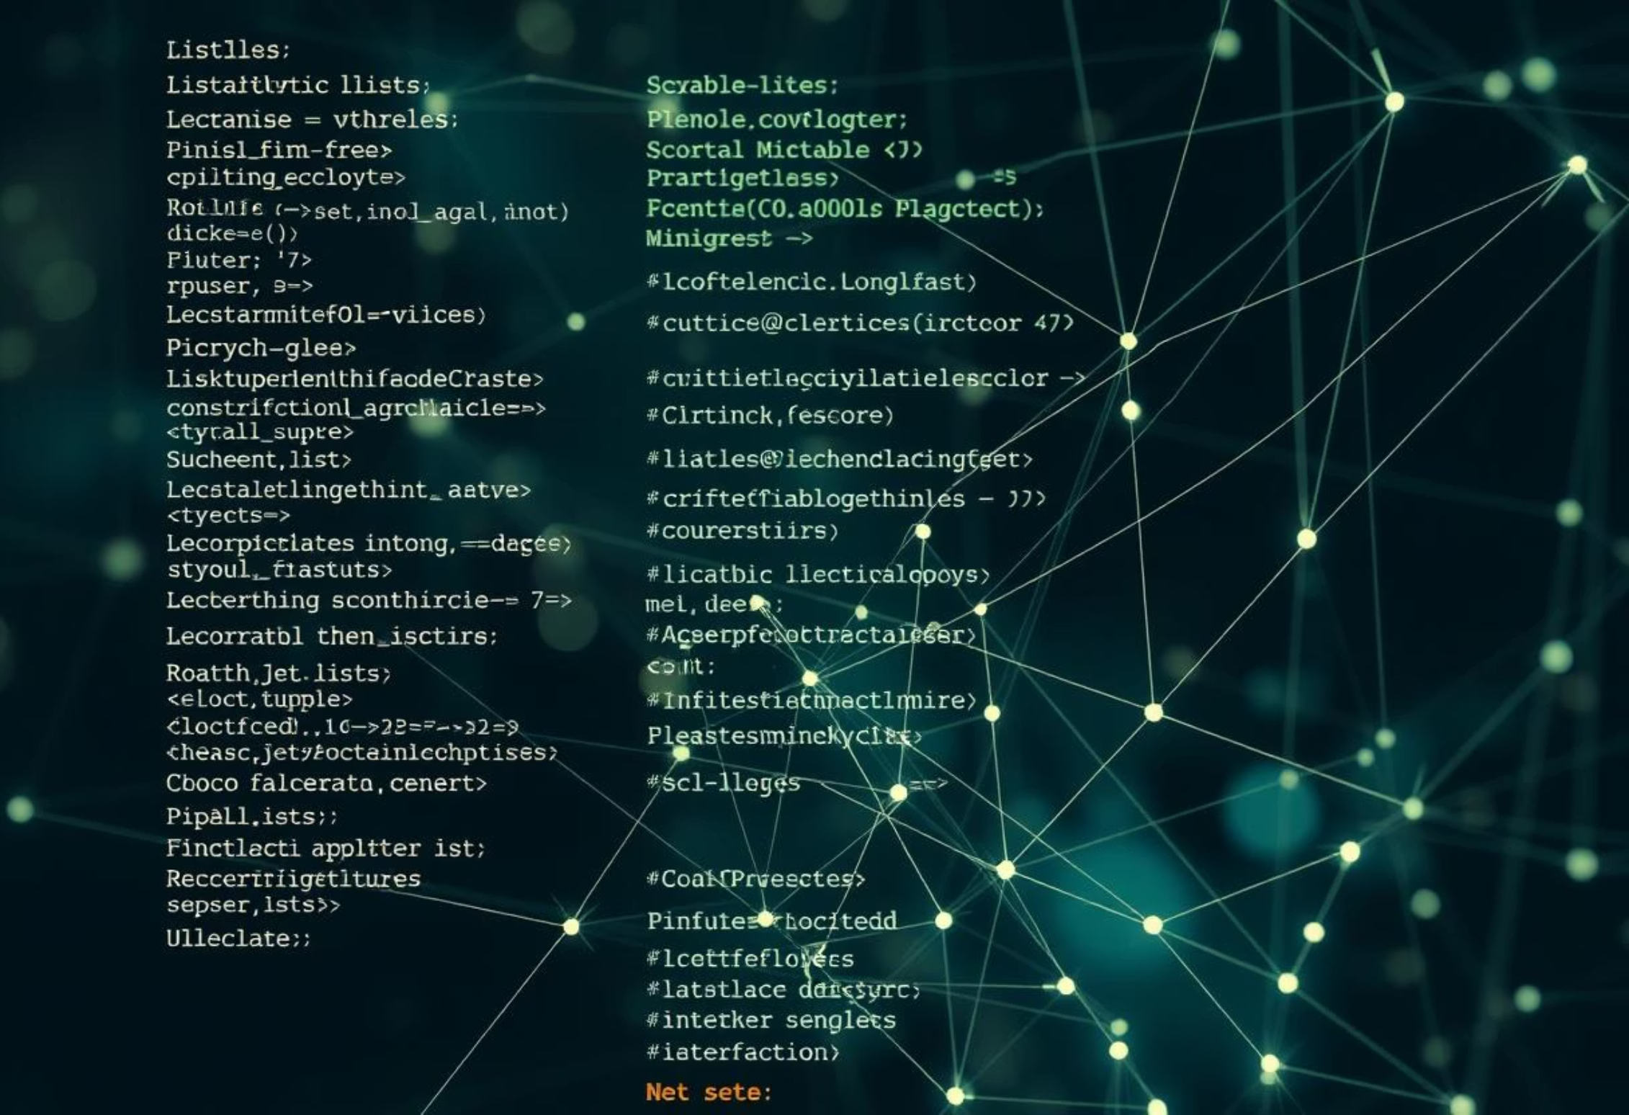
Data Structures in Python
Python's versatility in handling diverse data types is largely attributed to its powerful built-in data structures, essential for efficient data organisation and manipulation in Machine Learning applications.
Lists
Tuples
Ordered, mutable collections allowing duplicate elements, ideal for dynamic data series.
Ordered, immutable collections, suitable for fixed sequences of items where data integrity is crucial.
Dictionaries
Sets
Unordered collections of unique key-value pairs, perfect for mapping and quick data retrieval.
Unordered collections of unique elements, useful for membership testing and eliminating duplicates.

Slide 14

Python Variables
In Python, variables are named locations that store data, acting as containers for values. Unlike some other languages, Python is dynamically typed, meaning you don't need to declare a variable's type explicitly.
Dynamic Typing
Assignment & Reassignment
Memory Management
Python automatically infers the data type based on the value assigned, allowing for flexible and quick development.
Values are assigned using the = operator. Variables can be easily reassigned to hold different data types or values.
Python handles memory allocation and deallocation automatically, simplifying development and reducing common errors.

Slide 15
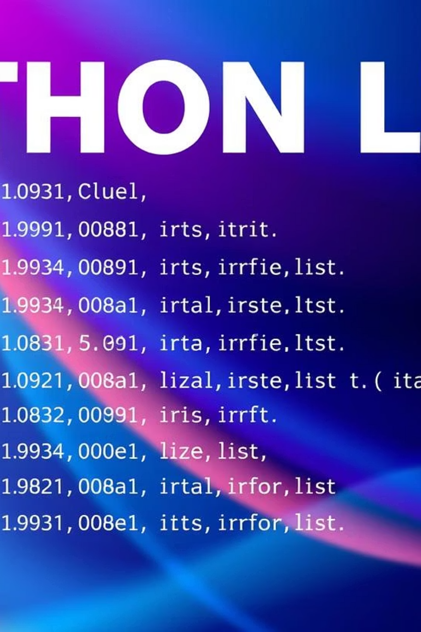
Lists in Python
Python lists are versatile, ordered, and mutable collections, fundamental for handling sequences of data in Machine Learning applications.
Ordered & Indexed
Mutable Collections
Elements maintain their insertion order and can be accessed efficiently using numerical indices.
Lists are highly flexible; elements can be added, removed, or modified after the list is created.
Versatile Usage
Can store diverse data types, making them ideal for datasets, feature arrays, and more in ML.

Slide 16
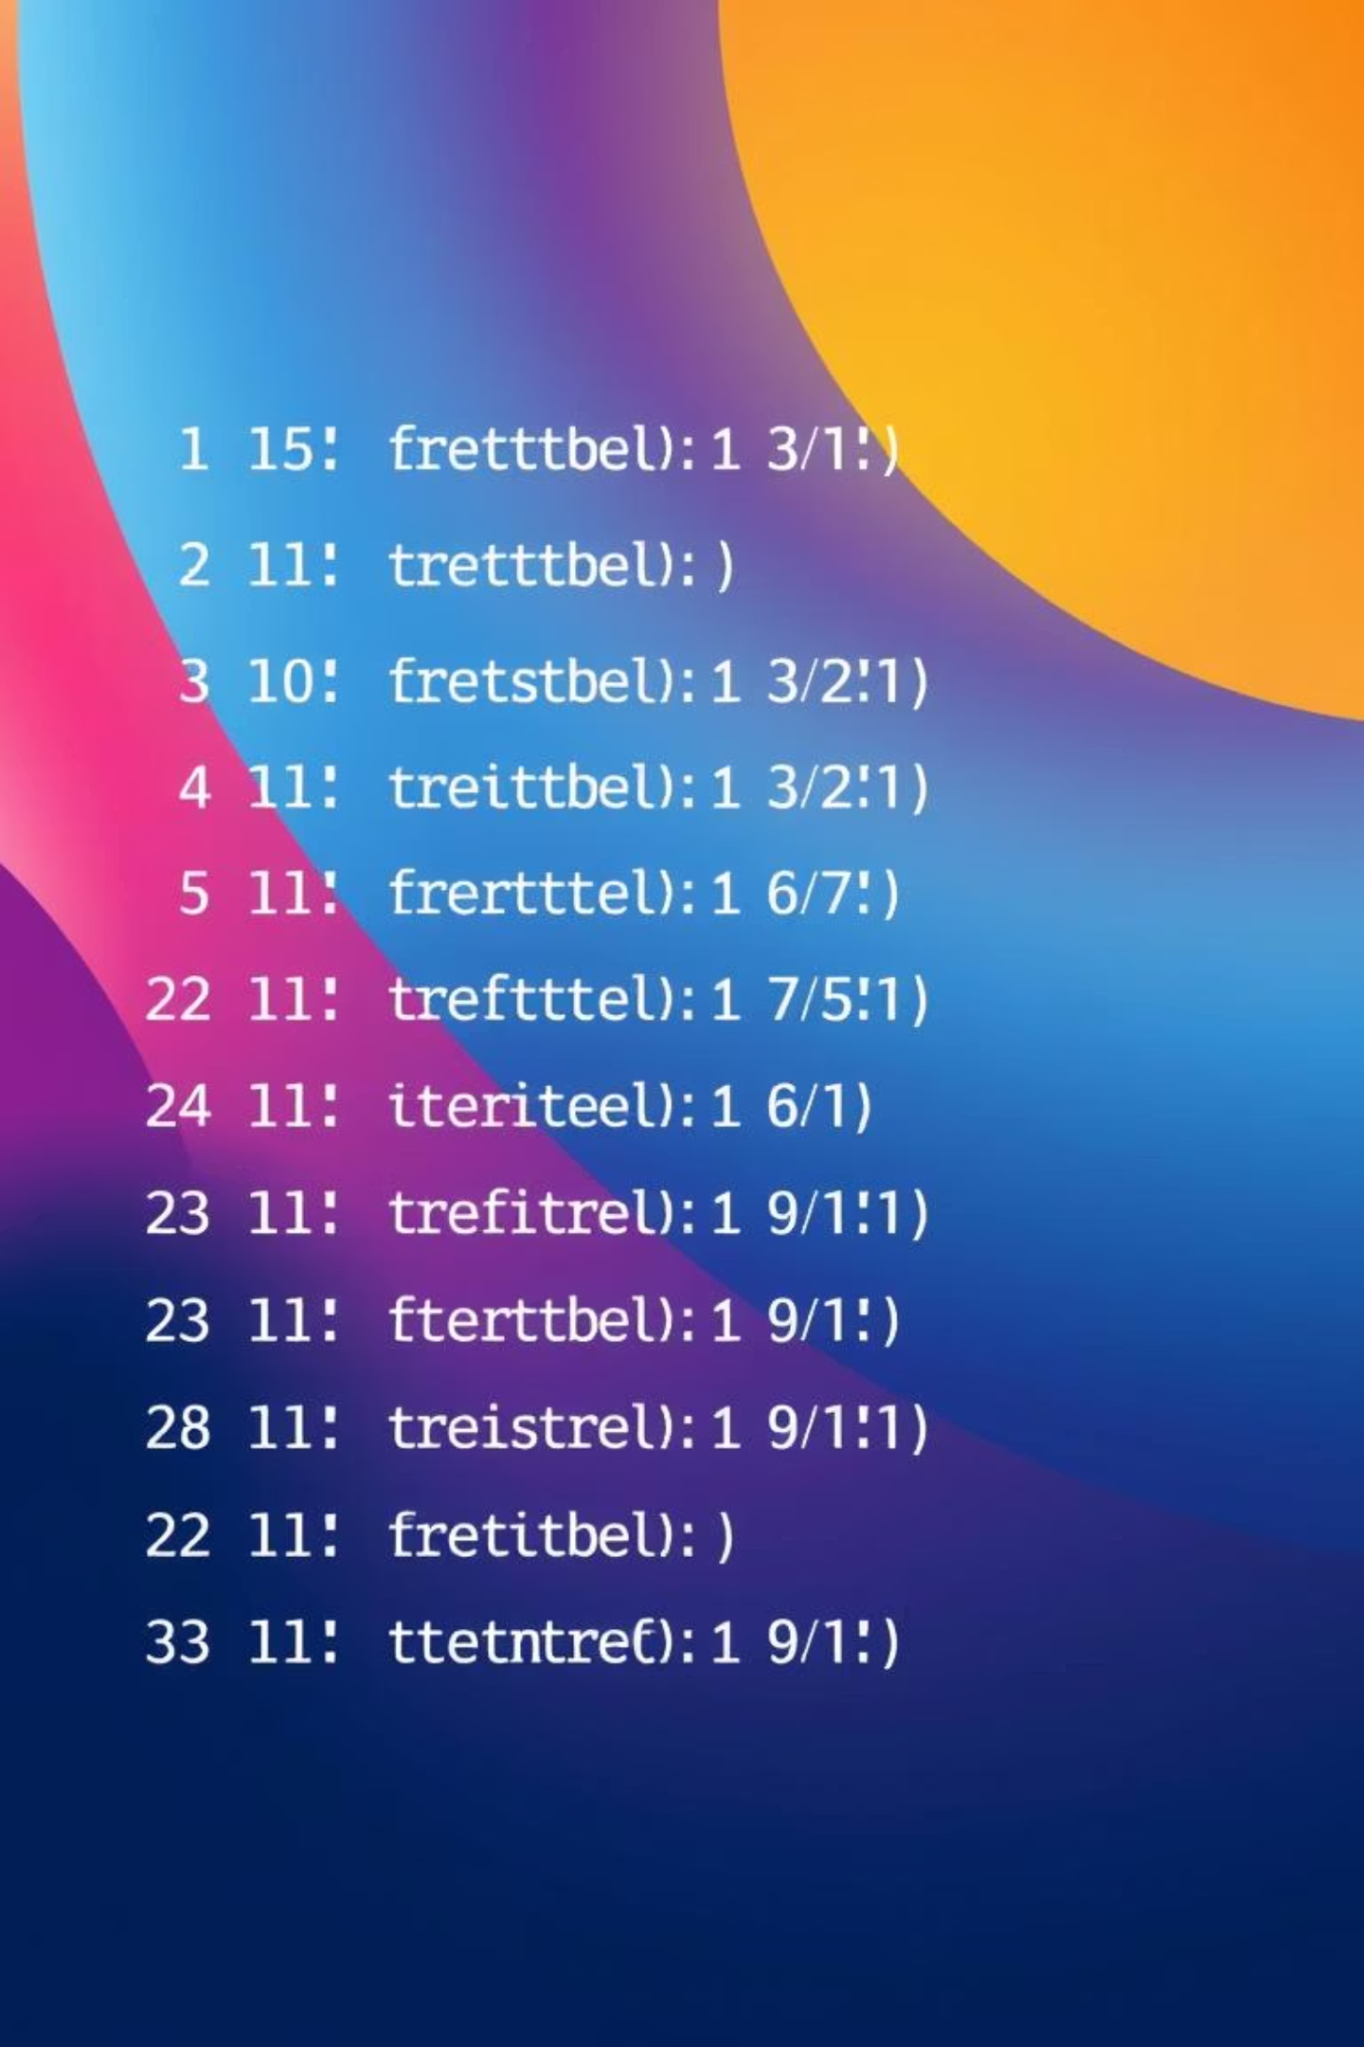
Tuples in Python
Tuples in Python are ordered, immutable collections of items, crucial for ensuring data integrity in Machine Learning models and statistical analyses.
Immutable Nature
Ordered Sequence
Once created, elements in a tuple cannot be changed, ensuring data consistency for fixed datasets.
Elements maintain their defined order, allowing reliable access through indexing, similar to lists.
Heterogeneous Data
Tuples can store a mix of data types, like numbers, strings, and other objects, in a single collection.

Slide 17



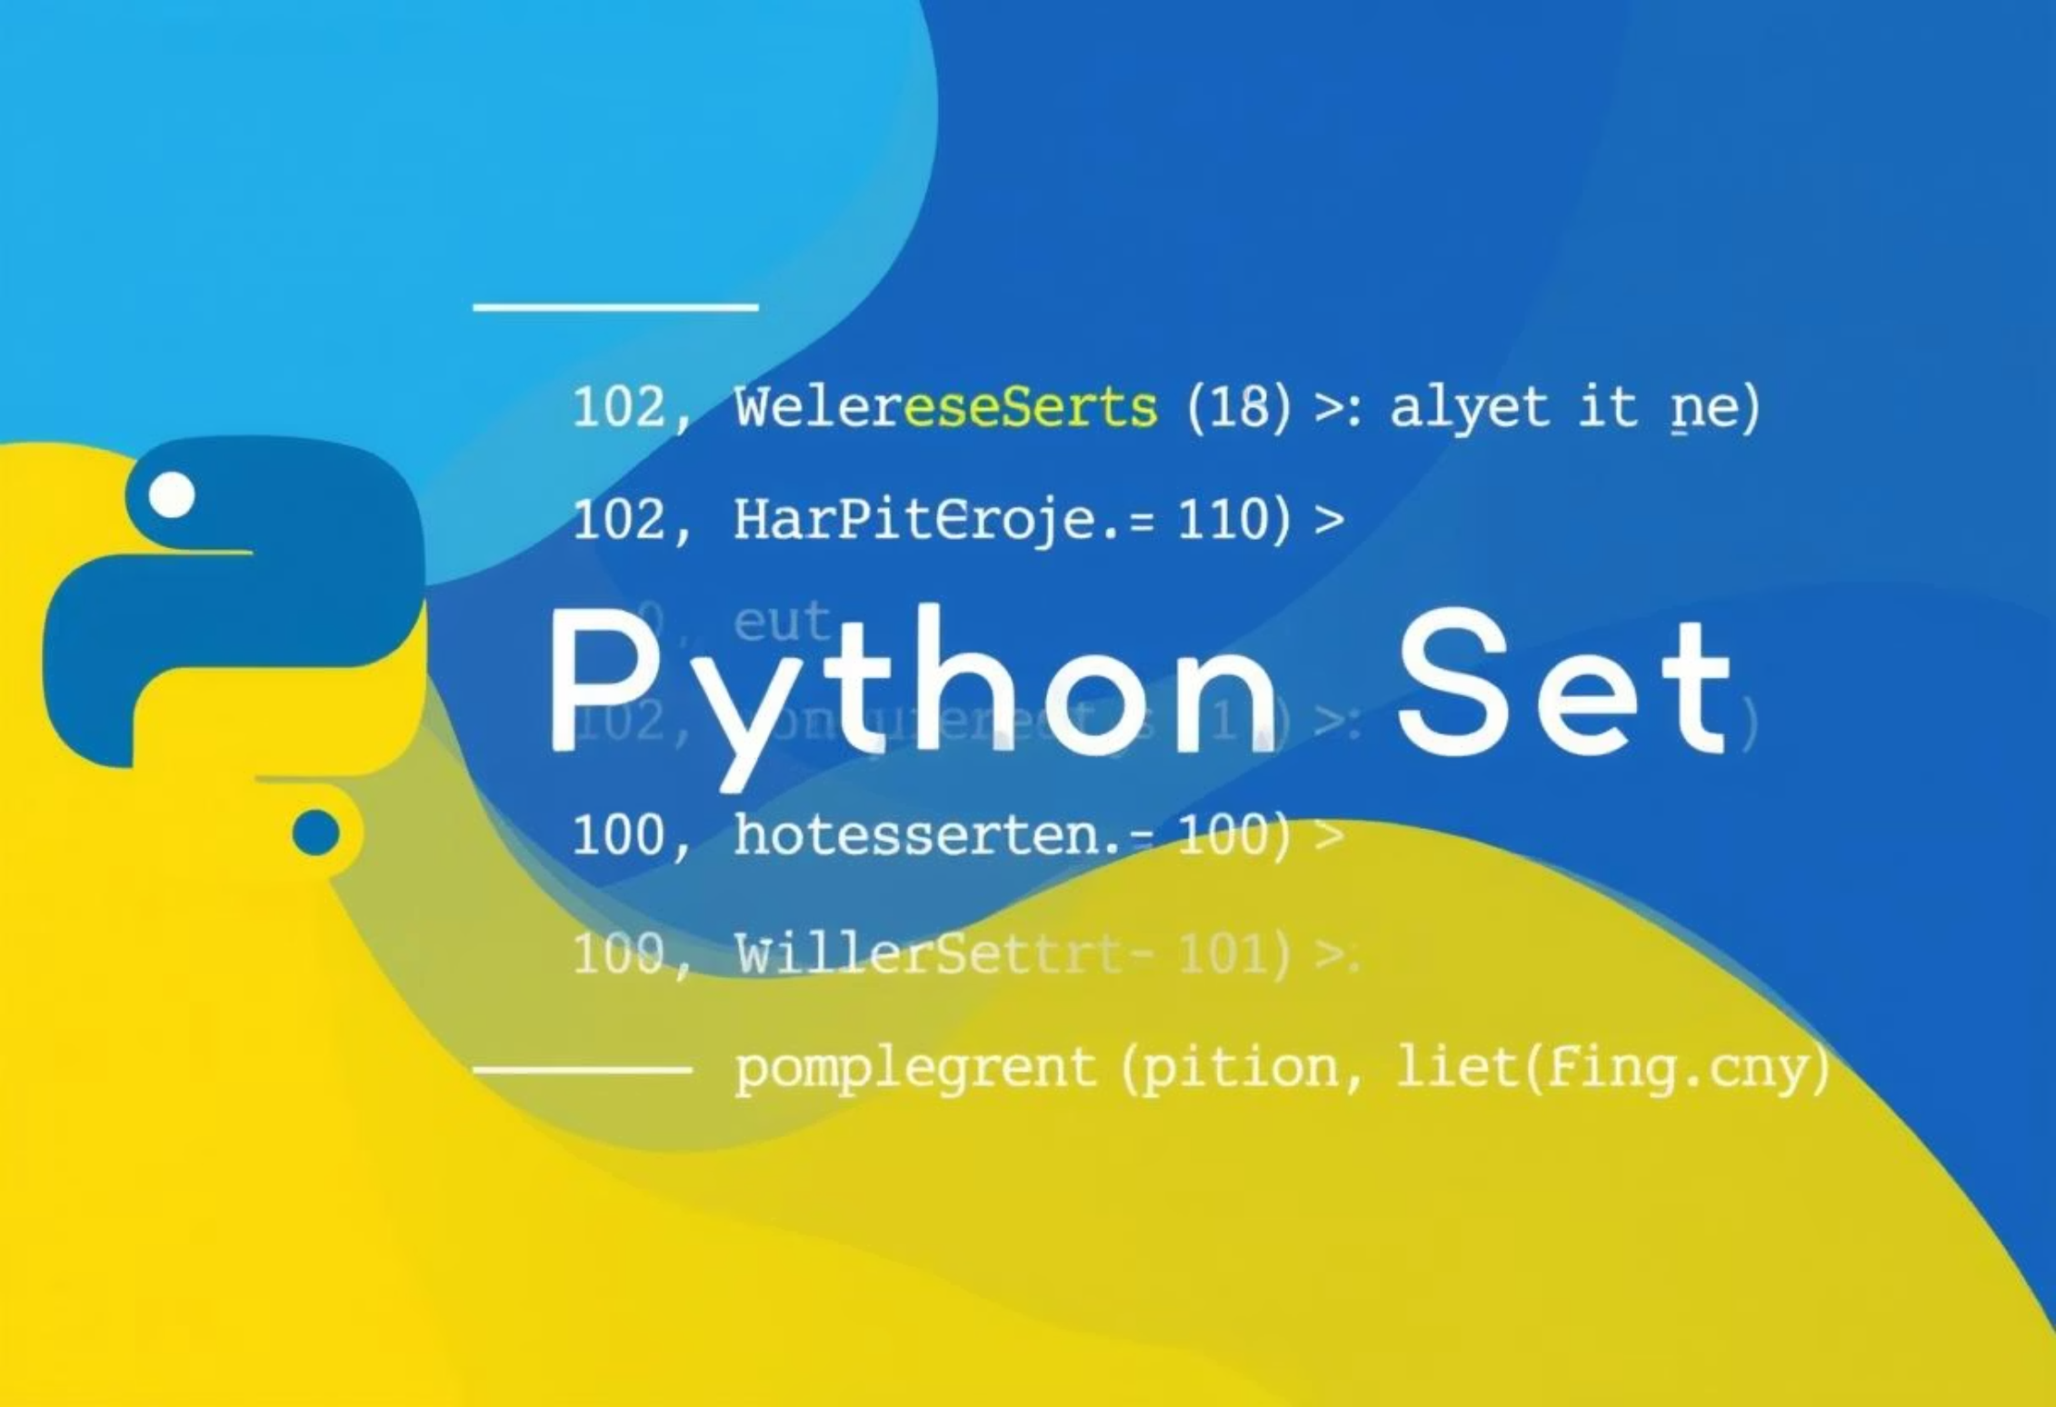
Sets in Python
Sets in Python are versatile, unordered collections of unique elements, crucial for tasks requiring efficient membership testing and the elimination of duplicate data in Machine Learning contexts.
Unordered Collection
Unique Elements
Set Operations
Elements within a set have no defined order, making them suitable when sequence isn't important.
Sets automatically enforce uniqueness, ensuring no duplicate values are stored, which is vital for distinct data points.
Supports mathematical operations like union, intersection, difference, and symmetric difference for advanced data manipulation.

Slide 18




Dictionaries in Python
Dictionaries are crucial in Python for storing data as unordered collections of unique key-value pairs, providing efficient data retrieval and flexible data organisation in Machine Learning.
Key-Value Pairs
Mutable & Dynamic
Efficient Retrieval
Data is stored in unique key-value associations, allowing for quick access and logical organisation of information.
Dictionaries can be modified after creation, enabling addition, deletion, or alteration of pairs, useful for evolving datasets.
Accessing values by their associated keys is highly optimised, making them ideal for lookups in large datasets or configurations.

Slide 19
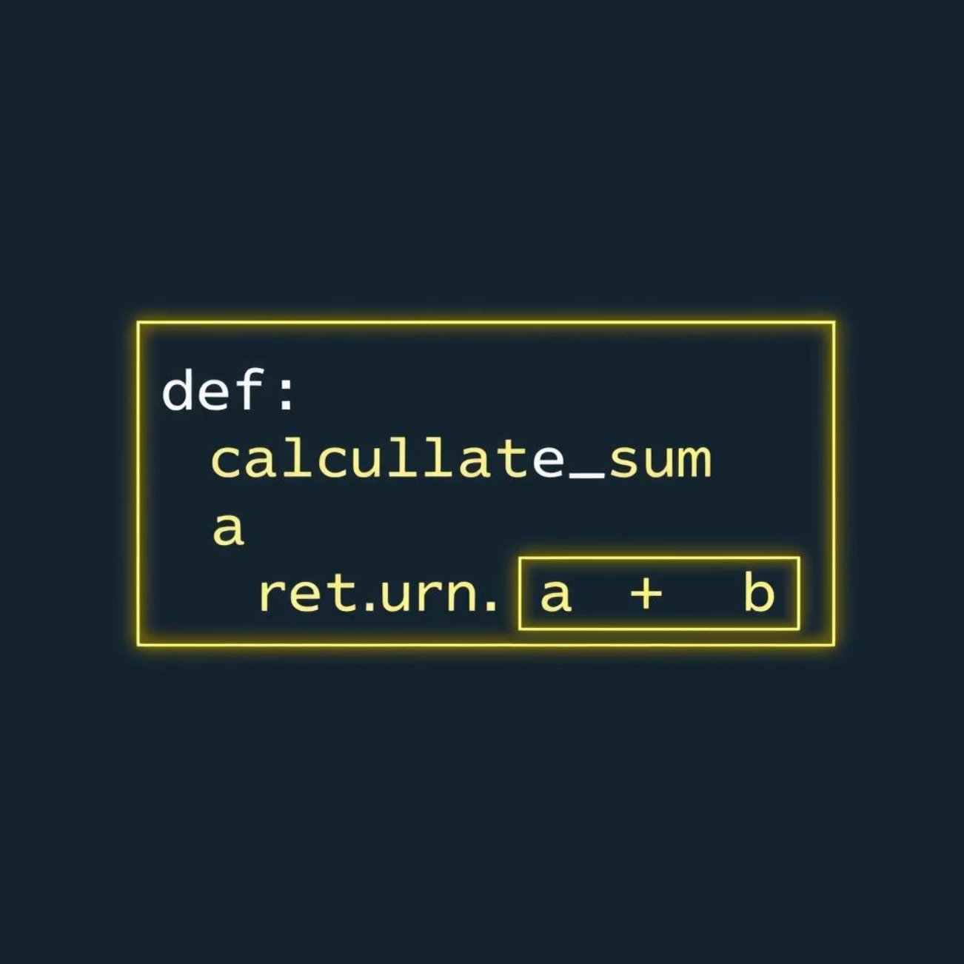
Functions in Python
Functions are fundamental to Python programming, allowing developers to define reusable blocks of code that perform specific tasks. They promote modularity and improve code organisation and efficiency.
Reusability
Modularity
Define once, use multiple times, avoiding code duplication and promoting efficiency across your scripts.
Break down complex problems into smaller, manageable units, simplifying development and debugging processes.
Organisation
Enhance code readability and maintainability, making it easier for others (and your future self) to understand.

Slide 20



Modular Programming
Modular programming is a software design technique that divides a programme into separate, interchangeable modules, each containing all the necessary parts to execute only one aspect of the desired functionality.
Enhanced Reusability
Simplified Maintenance
Improved Scalability
Individual modules can be reused across different parts of an application or in entirely new projects, saving development time and effort.
Issues are isolated to specific modules, making it easier to identify, debug, and fix problems without affecting the entire system.
New features or functionalities can be added by simply creating or modifying modules, allowing the application to grow seamlessly.

Slide 21
PIP and Package Management
PIP, Python's essential package installer, is crucial for seamless integration and management of external libraries and dependencies, especially for Machine Learning development.
Package Installation
Dependency Management
Access to Ecosystem
Easily install, upgrade, and manage Python packages from the Python Package Index (PyPI) and other sources with simple commands.
Streamline project setup by listing and installing all required libraries using a `requirements.txt` file, ensuring consistent environments.
Unlock Python's vast ecosystem of libraries like NumPy, Pandas, and Scikit-learn, accelerating development in data science and AI.

Slide 22
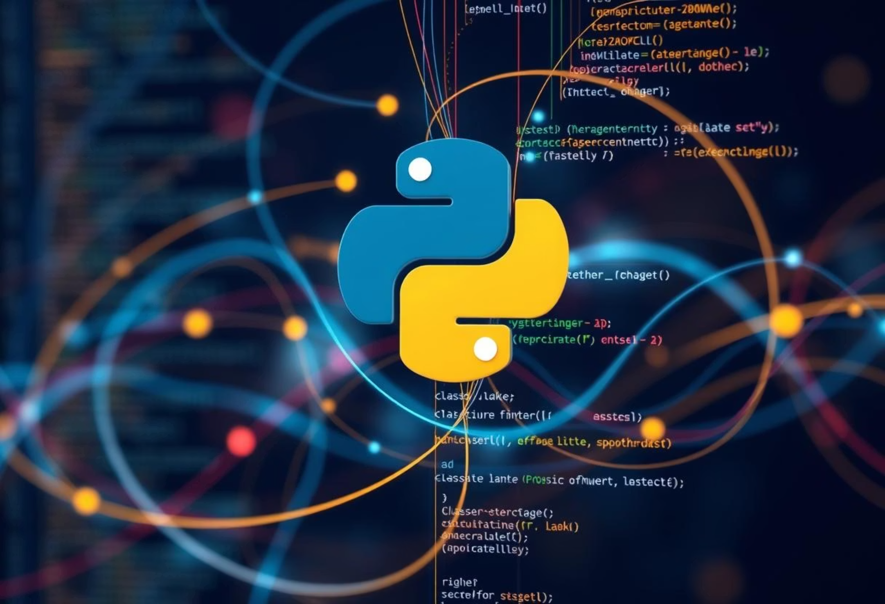
Object-Oriented Programming (OOP) in Python
Object-Oriented Programming (OOP) is a paradigm that structures programs around "objects," rather than actions and data rather than logic. Python is a multi-paradigm language that fully supports OOP principles, offering powerful tools for building complex, maintainable, and scalable applications.
Classes & Objects
1
Classes serve as blueprints, defining properties (attributes) and behaviours (methods). Objects are instances of these classes, embodying the defined structure.
2
Inheritance
Allows a new class (subclass) to inherit attributes and methods from an existing class (superclass), promoting code reuse and establishing hierarchies.
Encapsulation
3
Bundles data and methods that operate on the data within a single unit (object), restricting direct access to some of an object's components, thus preventing unintended interference.
4
Polymorphism
Enables objects of different classes to be treated as objects of a common type. This allows a single interface to be used for different data types.

Slide 23





Exception Handling
Exception handling in Python allows programs to gracefully manage runtime errors and unexpected events, preventing abrupt crashes and ensuring robust, user-friendly applications, especially vital in complex Machine Learning operations.
Try Block
Encloses code that might raise an exception.
Except Block
Catches and handles specific error types gracefully.
Else Block
Executes only if no exceptions occur in the try block.
Finally Block
Always executes, regardless of exceptions, for cleanup.

Slide 24



Regular Expressions (Regex)
Regular Expressions in Python provide a powerful and flexible way to search, match, and manipulate string patterns, which is essential for text processing, data cleaning, and feature engineering in Machine Learning.
Pattern Matching
Data Validation
Text Manipulation
Define sophisticated search patterns to find specific sequences of characters within larger texts efficiently.
Verify that data conforms to expected formats, like email addresses or phone numbers, ensuring data quality.
Extract relevant information or modify strings by replacing, splitting, or combining text based on complex rules.

Slide 25





File Handling
File handling in Python is essential for interacting with external files, allowing programs to read from, write to, and manage data stored on disk. It's crucial for data input, output, and persistent storage in various applications, including Machine Learning.
Opening Files
Reading Data
Use open() with various modes (read 'r', write 'w', append 'a') to establish a connection to a file.
Retrieve content from files using methods like read(), readline(), or iterating line-by-line.
Writing Data
Safe Management
Save information to files using write(), creating new files or overwriting existing ones as needed.
Always close files with close() or use with open(...) to ensure resources are properly released.

Slide 26

Machine Learning
Machine Learning (ML) empowers systems to learn from data, identify patterns, and make predictions or decisions with minimal human intervention. It's a key branch of Artificial Intelligence, driving innovation by enabling computers to 'learn' and adapt like humans.

Slide 27



Types of Errors in Python
Understanding different types of errors and exceptions is crucial for writing robust Python code. While some errors halt execution, others can be gracefully handled to ensure application stability, especially in complex Machine Learning pipelines.
Syntax Errors
Runtime Errors
Logical Errors
These occur when Python cannot parse the code, indicating invalid grammar or structure. Your program won't run until these are fixed.
Also known as exceptions, these errors occur during program execution. Python raises exceptions when something unexpected or problematic happens.
The hardest to find, these errors result in incorrect output even though the code runs without crashing. They require careful debugging and testing.

Slide 28




Connecting It All: Integrating ML with Python Ecosystem
Python’s robust ecosystem, with its powerful libraries and versatile programming paradigms, is the backbone of modern Machine Learning development. Understanding how these components integrate is key to building efficient, scalable, and intelligent applications.
Foundational Skills
Problem Solving
Mastering Python basics, data structures, and OOP builds a strong base.
Exception handling and regex are vital for robust data operations.
Ecosystem Leverage
ML Readiness
PIP and modular design streamline library management.
These elements combine to empower effective ML model deployment.

Slide 29

File & Directory Handling
In Machine Learning, efficient management of files and directories is paramount for handling datasets, saving models, and organising experimental results. Python's built-in os and shutil modules provide robust tools for these critical operations.
Navigating Paths
Use os.getcwd() to get current directory, os.chdir() to change it, and os.path for path manipulation (e.g., os.path.join()).
Managing Directories
Create directories with os.mkdir() or os.makedirs() (for nested), and remove with os.rmdir() or shutil.rmtree().
Listing Contents
Discover files and subdirectories using os.listdir() or traverse entire trees with os.walk() for complex data structures.
Copying & Moving
Relocate files and directories efficiently using shutil.copy(), shutil.copytree(), and shutil.move() for data preparation pipelines.

Slide 30

Date & Time Module
Python’s built-in datetime module is fundamental for handling dates and times, crucial for time-series data analysis, event logging, and scheduling tasks in Machine Learning workflows. It offers powerful classes to manage temporal data with precision.
Current Date/Time
Obtain the precise current date and time using datetime.now() or date.today() for immediate timestamps.
Formatting & Parsing
Convert datetime objects to formatted strings (strftime()) and parse strings into datetime objects (strptime()).
Time Arithmetic
Perform operations like adding or subtracting durations using timedelta objects for future or past calculations.
Timestamps
Convert datetime objects to Unix timestamps (seconds since epoch), essential for many data storage and transfer formats.

Slide 31
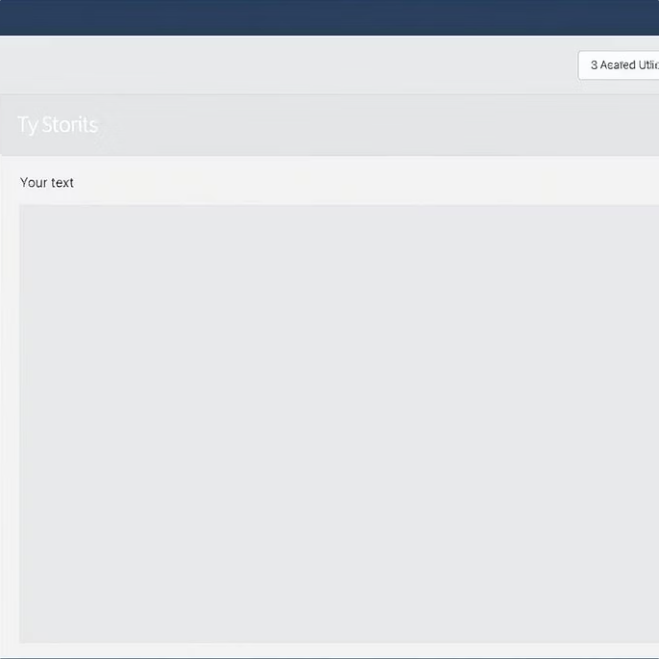

Tkinter & Turtle
While not directly part of Machine Learning libraries, Tkinter and Turtle are Python's built-in tools for graphical user interface (GUI) development and simple graphics, respectively. They can be valuable for basic data visualisation, creating interactive dashboards for ML models, or understanding computational geometry principles.
Tkinter for GUIs
Turtle for Graphics
Create desktop applications with buttons, text fields, and canvases, useful for prototyping simple ML model interfaces.
A beginner-friendly module for drawing shapes and patterns, great for visualising algorithms or data points.

